Slide 1
Virtual Facilitation Resources

Slide 2
Table of Contents
Resource Categories
Engagement & Participation
Managing Tricky Situations/People
Facilitating Hybrid Meetings (In-Person + Virtual Participants)

Slide 3
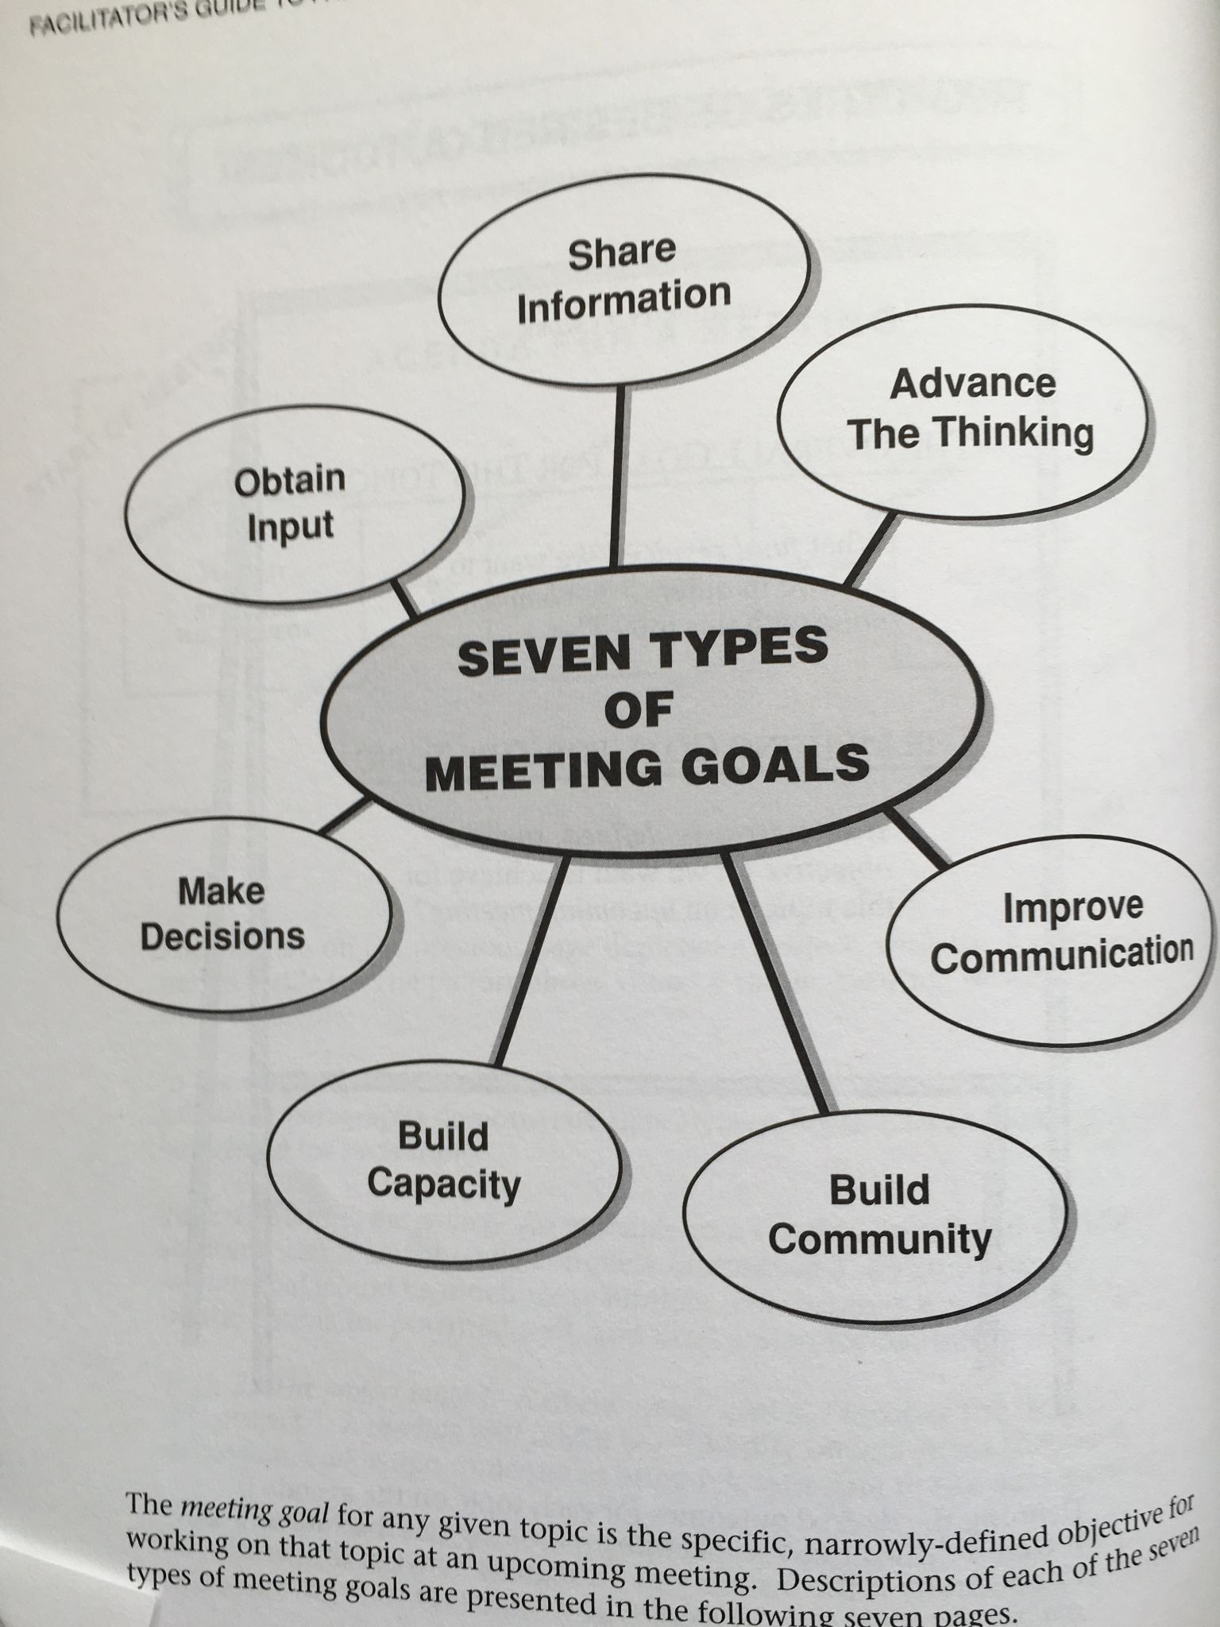
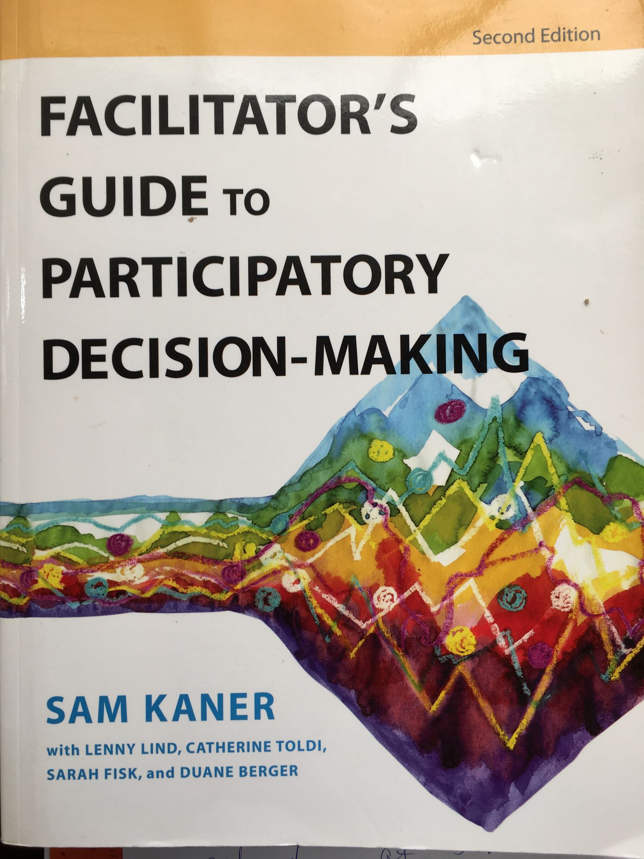
Book: Facilitator’s Guide to Participatory Decision-Making
EXAMPLE
Description
An eminently practical book by Sam Kaner and co-authors. So many wonderful resources to understand how to approach meeting design and to structure your meeting to align to your goals (see right). Highly recommended.
Links
Book on Goodreads
Category: Agenda Building
Resource Type: Book

Slide 4
ENGAGEMENT & PARTICIPATION
(Resources & Ideas)

Slide 5
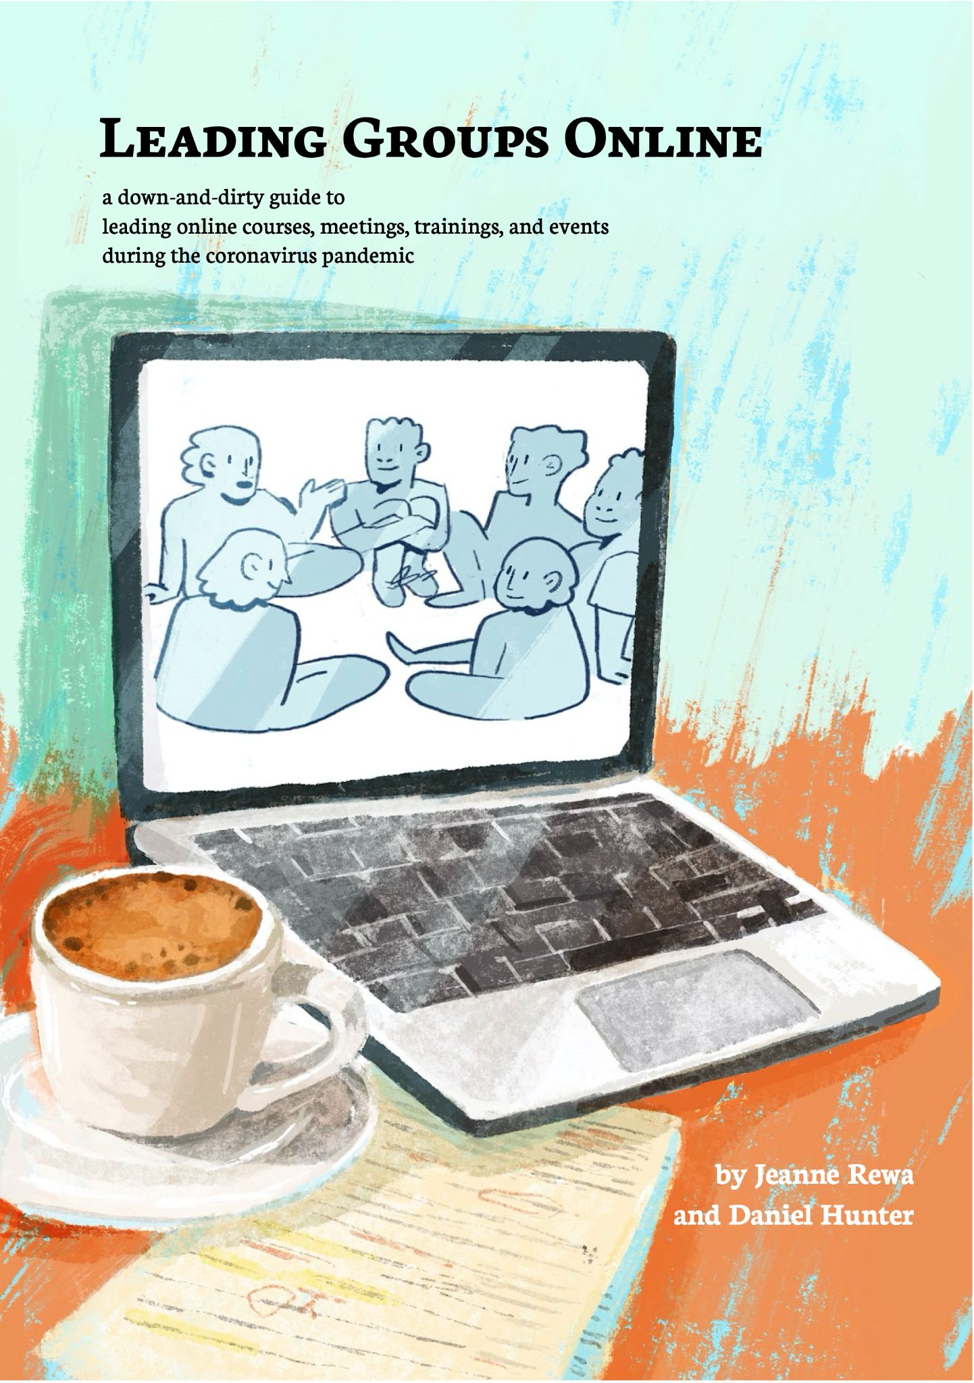
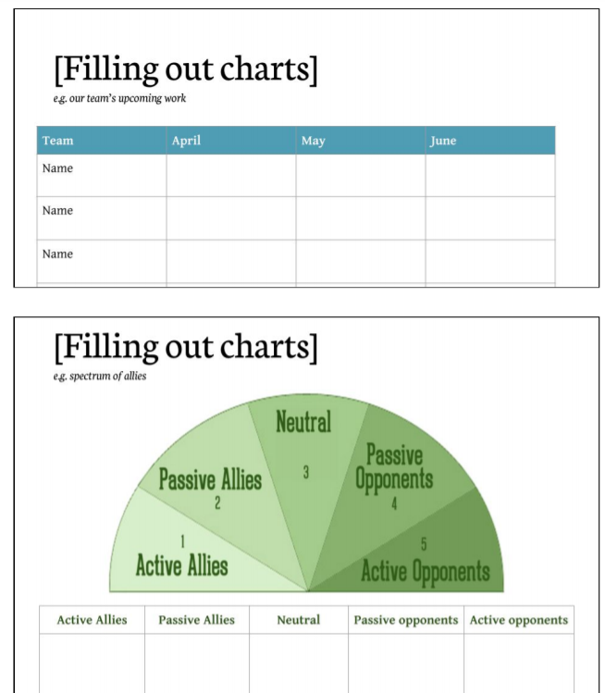
Leading Groups Online:
Description
Quick read with all the basics in one place, distilled to 10 Principles. Include lots of examples for use in any platform.
Links
Leading Groups Online - free download
Available in 5 languages
Category: General Engagement Principles
Resource Type: Guide/PDF with templates

Slide 6
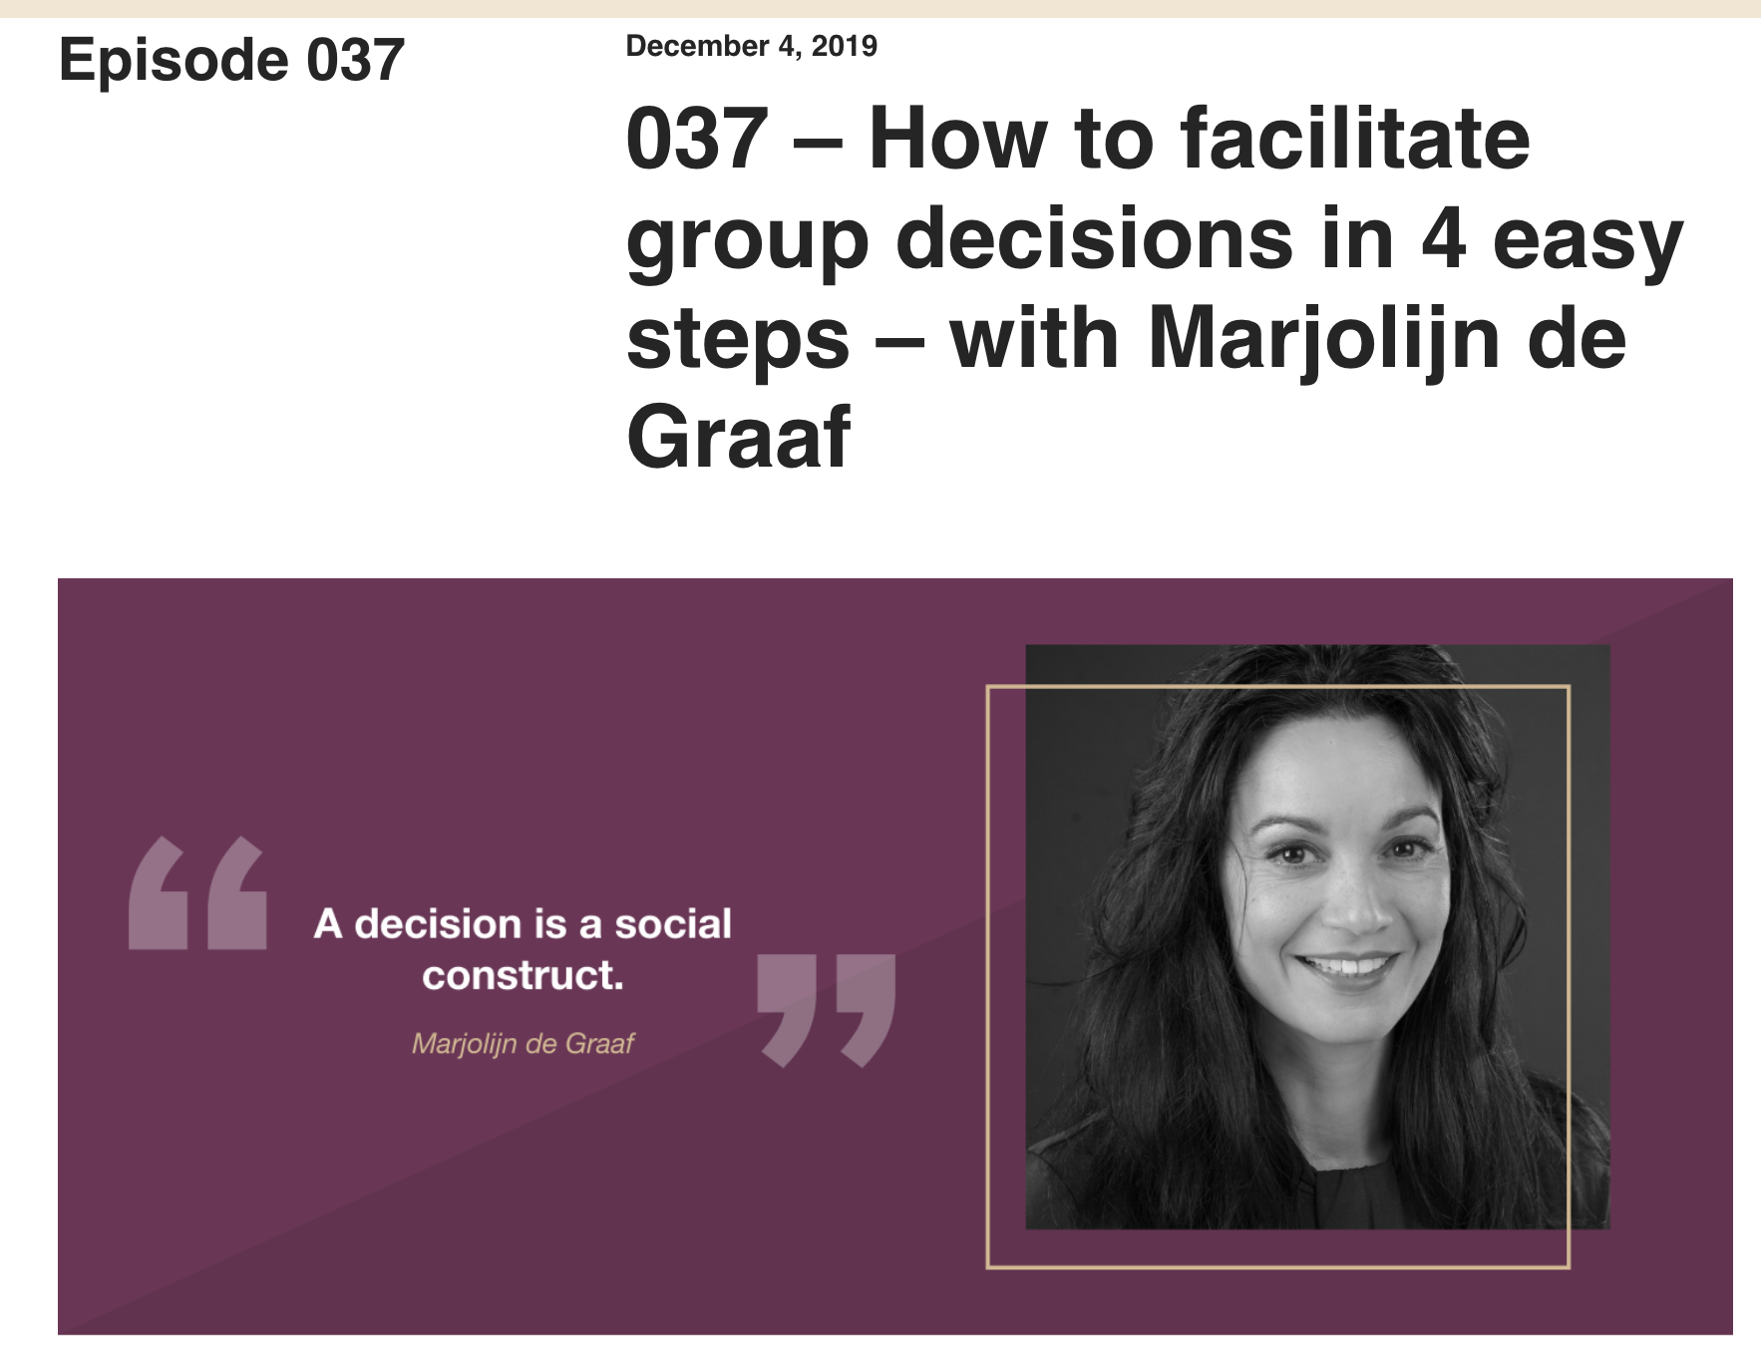
Podcast: Decision Making
Description
I’ve come to be a big fan of Myriam Hadnes’ work through https://workshops.work/. This conversation w/ “decision designer” Marjolijn de Graaf provides a great justification for being transparent about what you’re asking folks to do and how decisions are made. That transparency puts folks at ease and invites them to participate fully.
Links
https://workshops.work/podcast/037/
Category: Engagement
Resource Type: Podcast and website
Notes:
Comments:

Slide 7
7 Golden Rules for Hosting Webinars that Engage and Convert
Description
How do we create a webinar that’s engaging? How do we create a learning space that is interesting and gives the learner a reason to listen and participate?
Links
copyblogger.com/webinars-engage-convert/
Category: Engagement
Resource Type: Blog

Slide 8
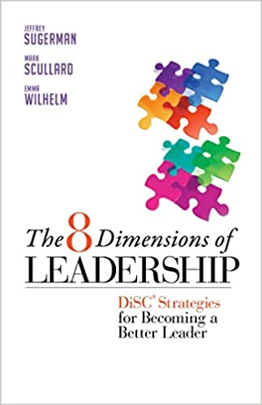
The 8 Dimensions of Leadership
(DiSC Strategies for Becoming a Better Leader)
Description
Helps you identify yours and coworkers styles of leadership
Helps showcase how everyone brings something different to the table and to complement each other.
Links
Found on Amazon and Library websites
Category: Leadership
Resource Type: Book

Slide 9
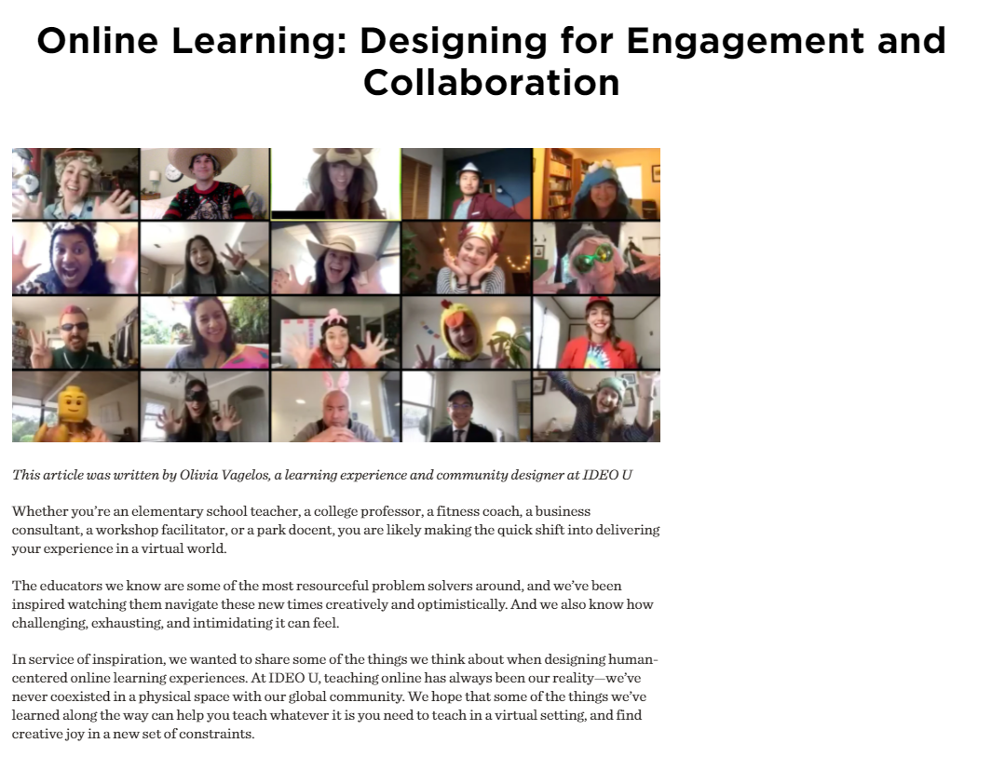
IDEO U - Online Learning: Designing for Engagement and Collaboration
Description
Tips and reflection/ design questions to help adapt material and identify appropriate engagement techniques for the virtual environment - written by Olivia Vagelos, a learning experience and community designer at IDEO U
Links
https://www.ideou.com/blogs/inspiration/online-learning-designing-for-engagement-and-collaboration
Category: Engagement
Resource Type: Blog

Slide 10
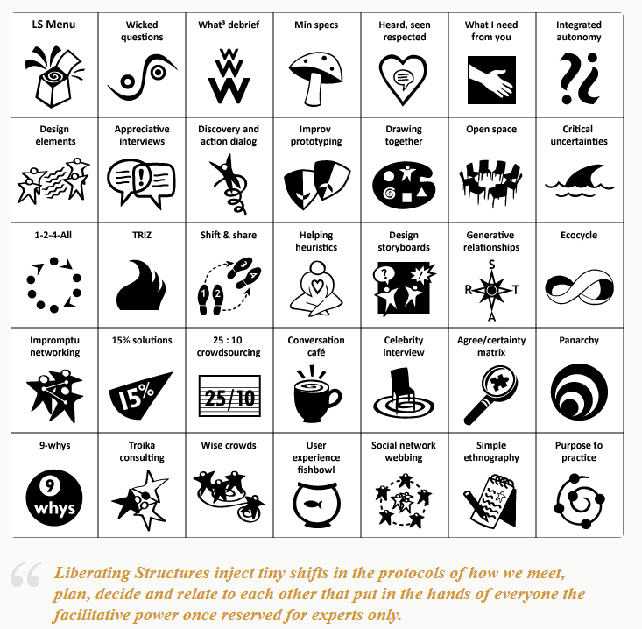
Liberating Structures Menu
Description
A menu of activities and approaches to encourage inclusive interactions, listening, and planning. Each is presented as a “mini” facilitation guide. Range from simple to complex.
Links
Liberating Structures menu of approaches
Category: Engagement
Resource Type: Website

Slide 11
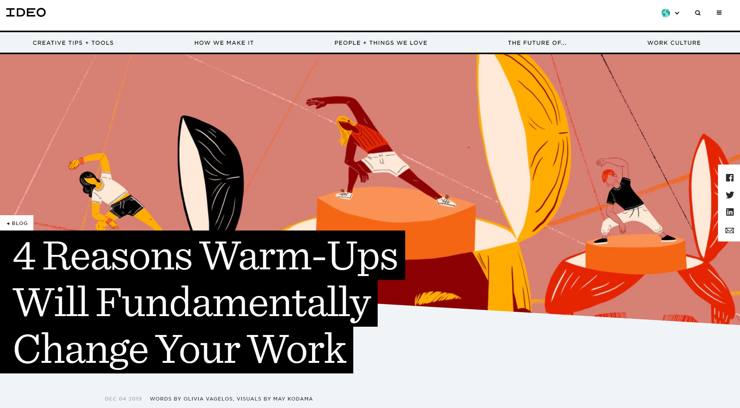
IDEO: 4 Reasons Warm-Ups Will Fundamentally Change Your Work
Description
Provides 4 reasons that warm-ups are important for collaborative working sessions.
Links
https://www.ideo.com/blog/4-reasons-warm-ups-will-fundamentally-change-your-work
Category: Engagement
Resource Type: Blog

Slide 12
Excerpt: Seven Types of Meeting Goals
Description
The chart on the right from The Facilitator’s Guide to Participatory Decision-Making (p.162) provides an incredibly helpful list of things that we might want to accomplish during a meeting, or one small part of a meeting. Forcing yourself to identify what you want to accomplish is outrageously helpful for design -- and opens up a world of structures that align to that purpose.
Category: Agenda Building
Resource Type: Book

Slide 13
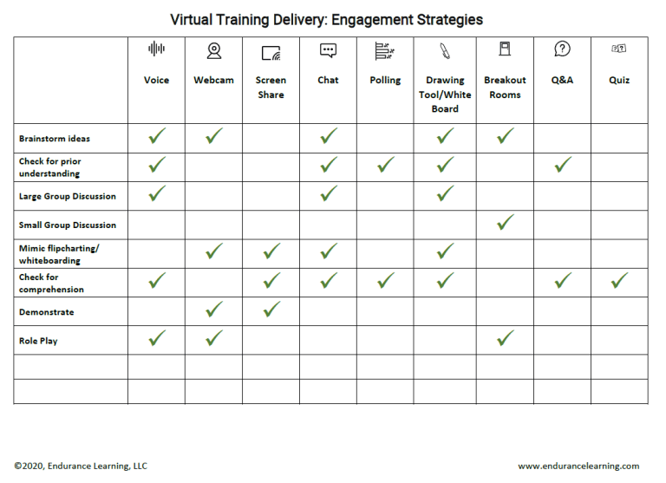
Virtual Training Delivery: Engagement Strategies
Description
Job aid offering quick ideas on matching virtual tools to type of engagement. Great for a quick reference!
Category: Engagement & Participation
Resource Type: Job Aid

Slide 14
MANAGING TRICKY SITUATIONS/PEOPLE
(Resources and Ideas)

Slide 15
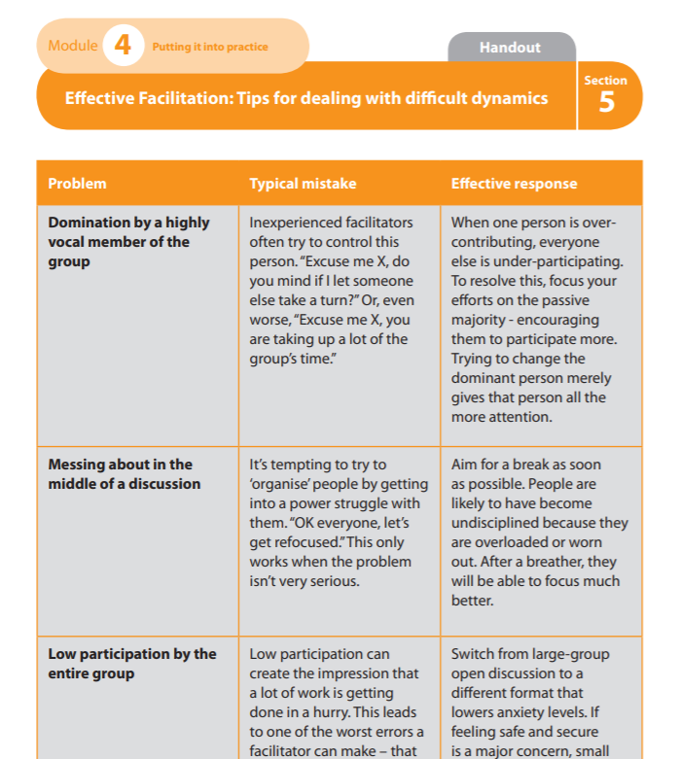
Effective Facilitation: Tips for dealing with difficult dynamics
Description
A handout of common problems, typical mistakes and effective solutions from the UK’s National Health Service Facilitator’s Toolkit
Links
See pages 69-74 in the Facilitator’s Toolkit
Category: Managing Tricky Situations/People
Resource Type: Handout

Slide 16
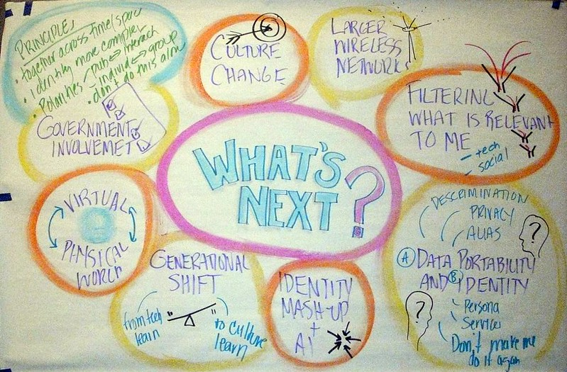
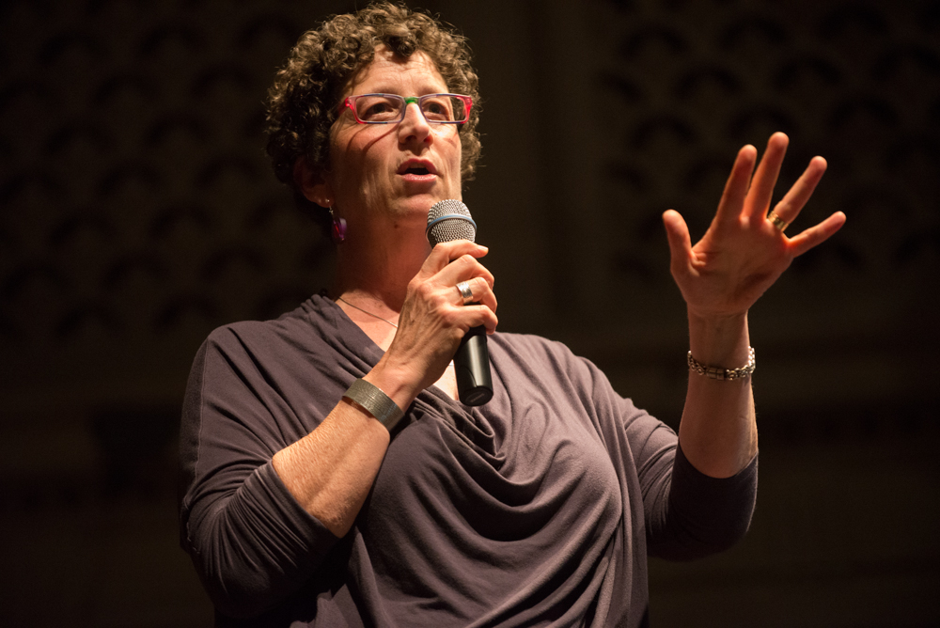
Management vs. Control and Oppression
Description
Nancy White (Full Circle Associates) warns against “facipulation” - controlling and oppressing others through well-meaning facilitation.
Links
https://fullcirc.com/2021/03/08/what-does-consent-look-like-to-you-as-a-facilitator/
Category: Managing Tricky Situations/People
Resource Type: Blog

Slide 17
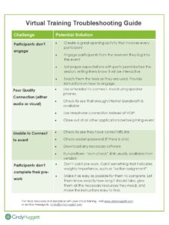
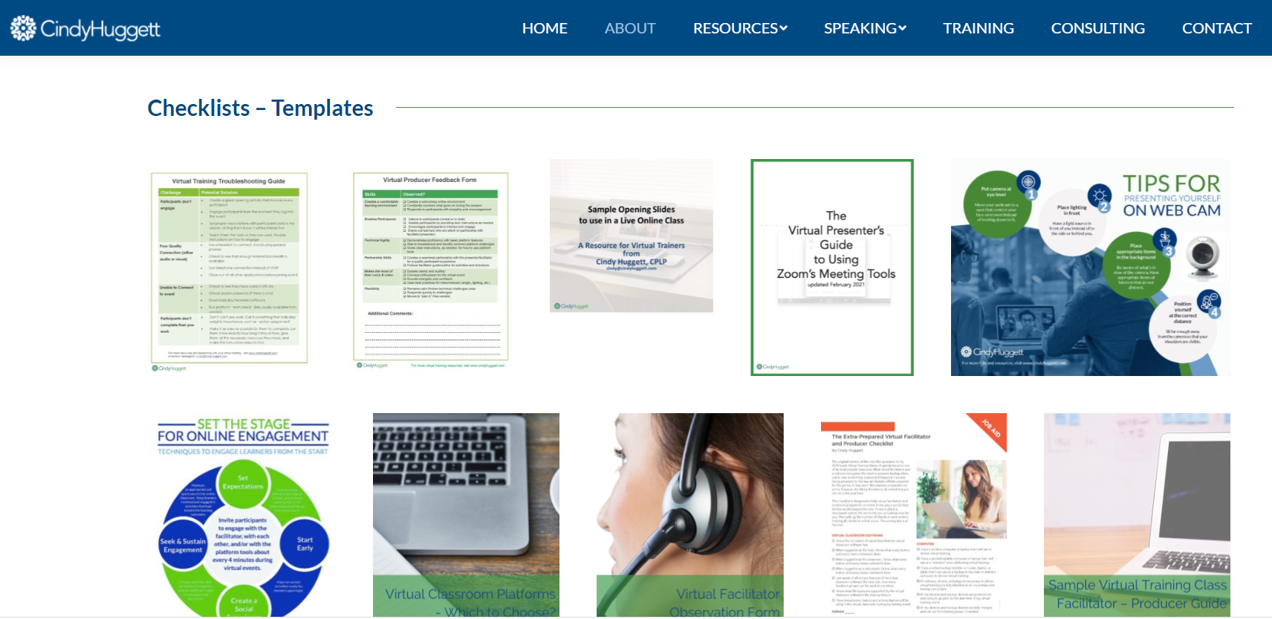
Virtual Training Troubleshooting Guide (and other checklists) by Cindy Huggett
Description
A very quick list of 4 common problems and potential solutions. Handy quick reference mid-event when things go wrong. Ultimately, planning ahead is your best defense! Check out her other resources.
Links
https://www.cindyhuggett.com/resources/#!/checklists
SCREENSHARE HERE
Category: Troubleshooting
Resource Type: Checklist/Reference

Slide 18
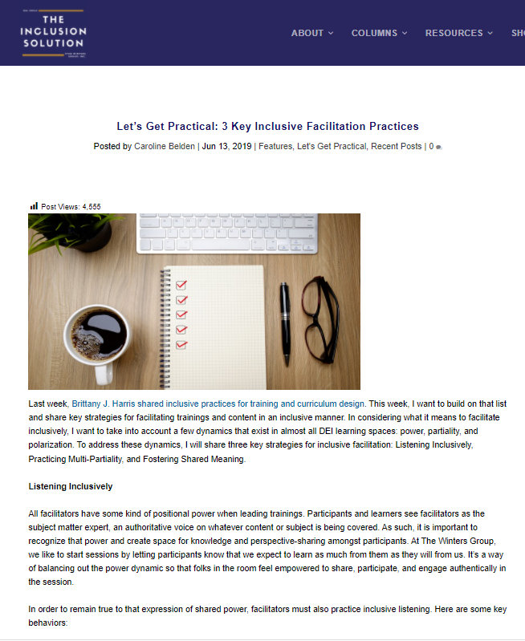
Techniques for Power Dynamics & Inclusive Facilitation Practices
Description
Recommended techniques for inclusiveness and dealing with power dynamics
Links
Let’s Get Practical: 3 Key Inclusive Facilitation Practices
Facilitator: Navigating power dynamics
Category: Managing Tricky Situations/People
Resource Type: blog

Slide 19
FACILITATING HYBRID MEETINGS in-person + virtual participants
(Resources and Ideas)

Slide 20
Resources may be hard to find!? Here’s some to get us started on what we even mean by “hybrid”
Tips for facilitating hybrid classes
Intro to Facilitating “Hybrid” Online Groups
Using Asynchronous Learning to EngageOnline Learners (Case Study)
Sierra Club: How to Draft: Hosting virtual/hybrid meetings

Slide 21
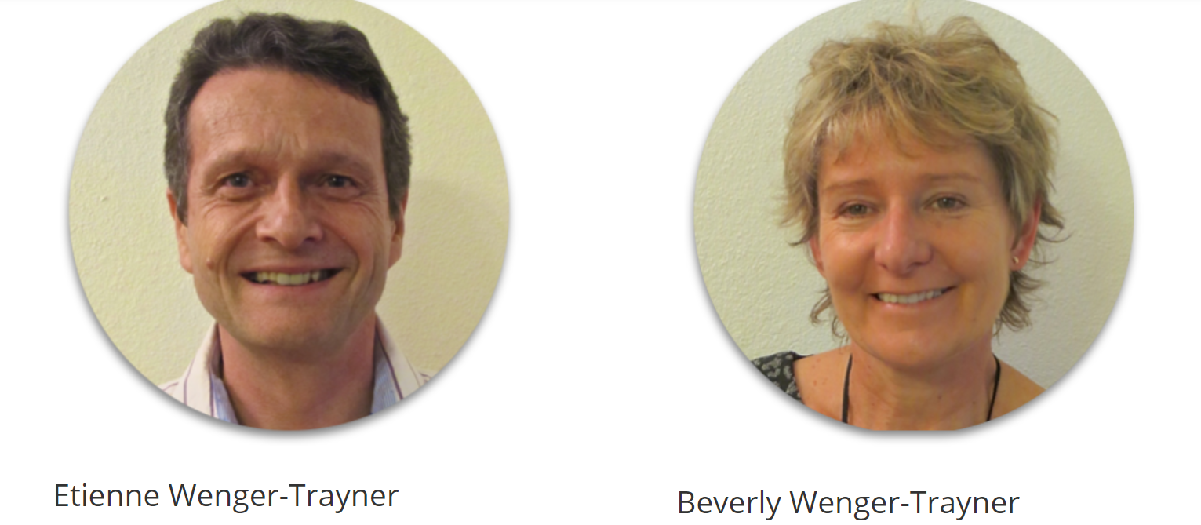
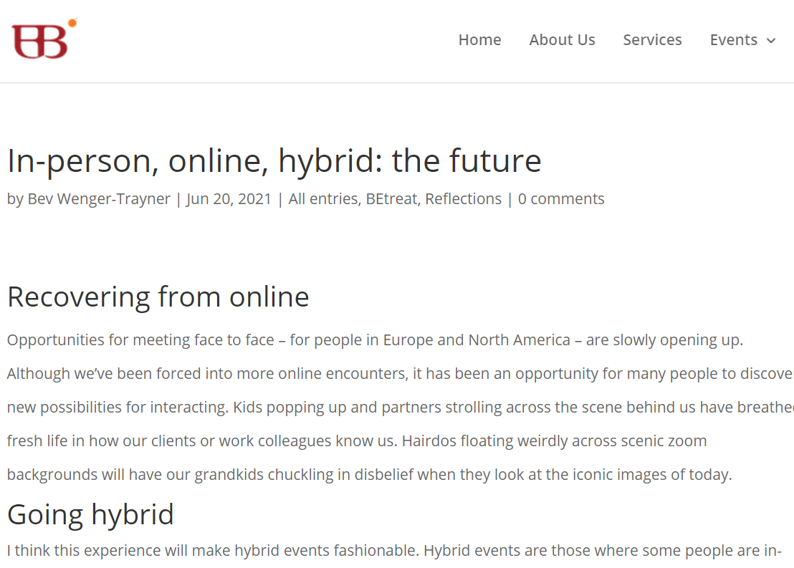
In-person, online, hybrid:
the future
IMAGE 1 HERE
IMAGE 2 HERE
Description
From KM4Dev - Bev Wenger-Trayner has just posted a great blog post giving some design and facilitation principles for hybrid events.
Links
https://wenger-trayner.com/reflections/in-person-online-hybrid-the-future/
SCREENSHARE HERE
Category: Facilitating Hybrid Meetings/Events
Resource Type: Blog Post

Slide 22
Article from HBR: What It Takes to Run a Great Hybrid Meeting
Up your audio game.
Explore a technology boost.
Consider video from the remote participant perspective.
Make remote participants full sized.
Test the technology in advance.
Design meetings for all attendees.
Provide strong facilitation.
Give each remote participant an in-room “avatar.”
Description
Eight best practices to help make your hybrid meetings more effective.
Links
https://hbr.org/2021/06/what-it-takes-to-run-a-great-hybrid-meeting
Category: Facilitating Hybrid Meetings/Events
Resource Type: Article

Slide 23
The Guide for Hosting Hybrid Gatherings - Priya Parker
I love her discussion of "the center of gravity" https://twitter.com/mweinraub87/status/1588627658212249600
-Micahel Weinraub
From the author of The Art of Gathering
Description
A short guide with tips for hybrid events. You need to sign in to receive the free guide.
Links
https://www.priyaparker.com/the-hybrid-gathering-guide
Category: Hybrid Facilitation
Resource Type: PDF Guide

